Slide 1
Remote Sensing of Forest Genetic Diversity and Assessment of Below Ground Microbial Communities in Populus tremuloides Forests
Mike Madritch - Appalachian State University
Phil Townsend –University of Wisconsin
Karen Mock – Utah State University
Rick Lindroth – University of Wisconsin
Notes:
The goal of this project is to use remote sensing techniques to quantify forest genetic diversity and resulting belowground microbial diversity. Understanding global declines in biodiversity is at the forefront of ecological research. To date, however, remote sensing techniques have yet to be applied to their full potential to address the genetic component of biodiversity. We are combining large-scale remote sensing data with fine-scale genetic data to understand of biological diversity across natural landscapes.

Slide 2
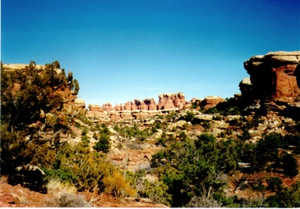
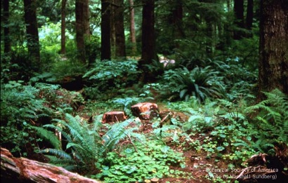
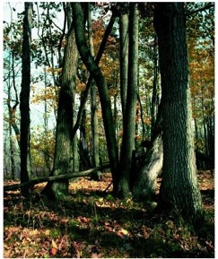
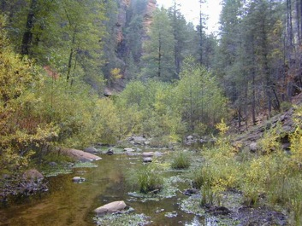
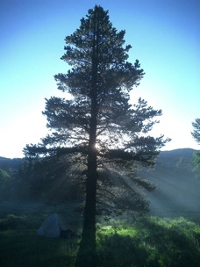
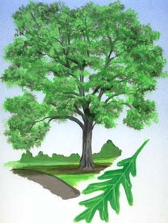

Biodiversity
"variation of life at all levels of biological organization“
Ecosystems
Communities
Species
Genotypes

Slide 3


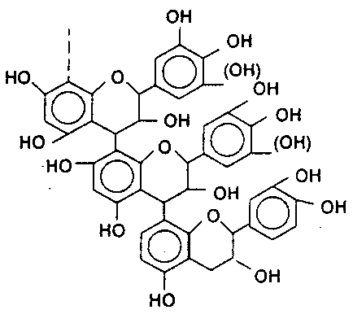
Environment
Genotype
Phenotype
Litter Chemistry
Nutrient Cycles

Slide 4
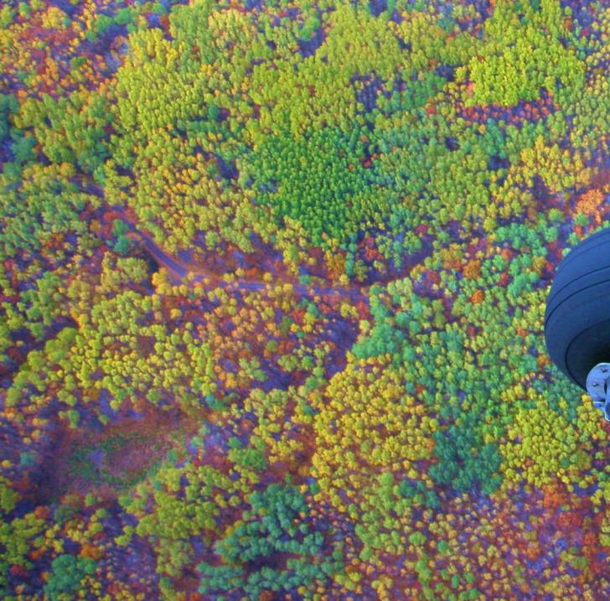
Notes:
4

Slide 5
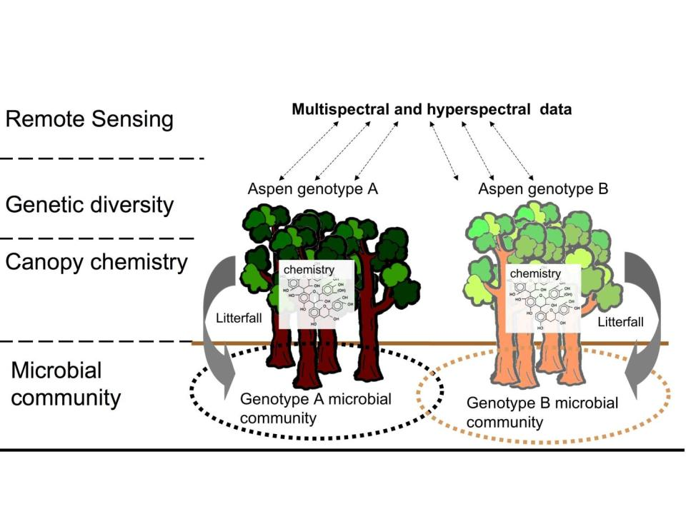
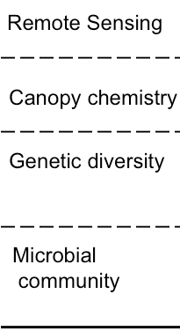
Notes:
5

Slide 6
Objectives
1. Estimate the genetic diversity of aspen stands across multiple ecoregions using remotely sensed data.
2. Build predictive models of genetically-mediated leaf chemistry using remotely sensed hyperspectral data.
3. Measure belowground microbial functional variation that results from genetically determined variation in plant chemistry.
6

Slide 7
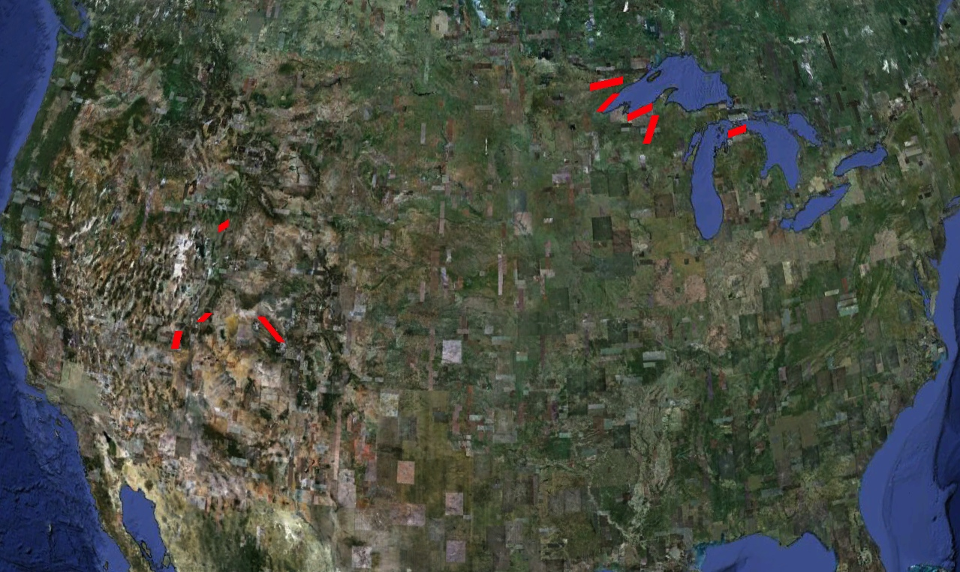

Slide 8
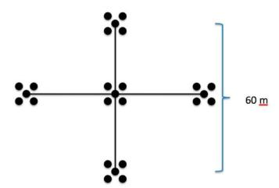
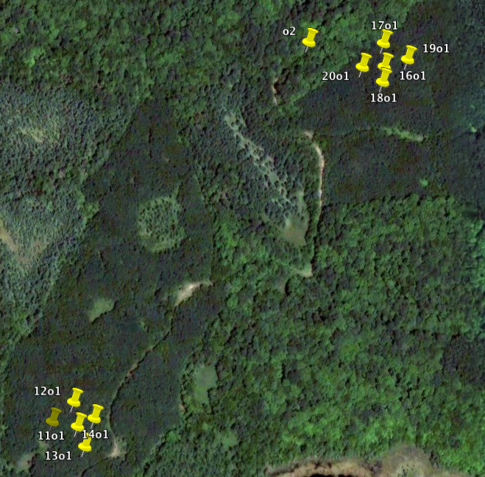
Genetic
Nutrient/microbial
Remotely-sensed
8

Slide 9
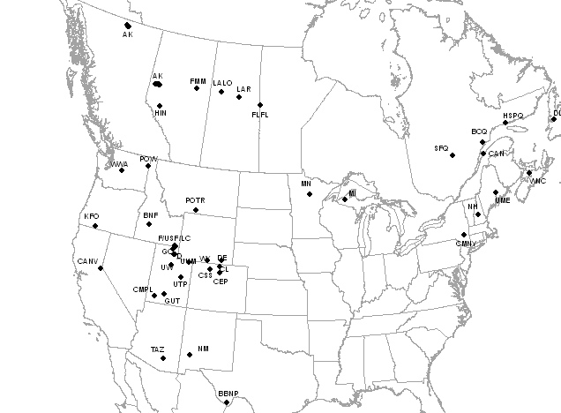
1. Genetic – aspen phylogeography
Hundreds of genotypes with multiple ramets
  Midwest tend to be small
  West tend to be large
  Polyploidy patterns
  Hotspots of genetic diversity

Slide 10
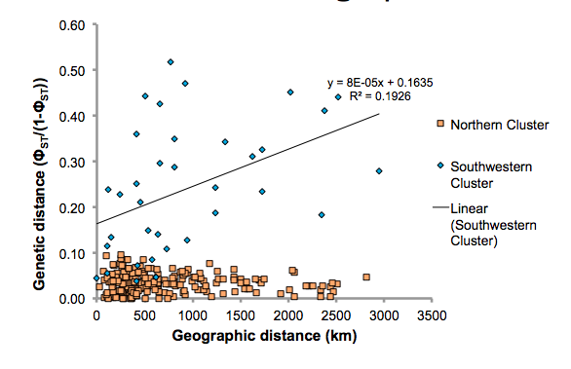
Genetic x Geographic
Callahan and Mock, unpub.
Notes:
From Mock: The genetic distance is a linearized version of Phi-st, which is like Fst...pairwise between populations. So each dot is a pair of populations. The scatter in the SW clade means that the populations are more separated from each other and each is on more of an independent pathway of genetic drift. So collectively in the SW there is a decent amount of genetic diversity because the independent trajectories of drift have captured different allele frequencies. The N clade is a completely different story; it looks like panmixia at a continental scale. Taken as a whole the N cluster is more diverse than the SW cluster, probably because of the huge population size...but the 'populations' are not very genetically different from each other in terms of allele frequencies.

Slide 11
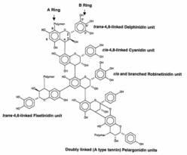
2. Leaf and Soil analyses
Leaf
  Carbon, nitrogen
  Condensed tannins, lignin
Soil
  Nutrient: C, N, NH₄⁺, NO₃⁻
  Microbial: extracellular enzymes,
  t-RFLP
11

Slide 12
3. Remote sensing
LANDSAT time series
  Use phenology to identify aspen clones
  Build time series databases normalized to end of season dates
Mid-summer AVIRIS imagery
  Spectral variation to estimate clonal differences
  Estimate canopy chemistry
    Estimate belowground microbial processes

Slide 13
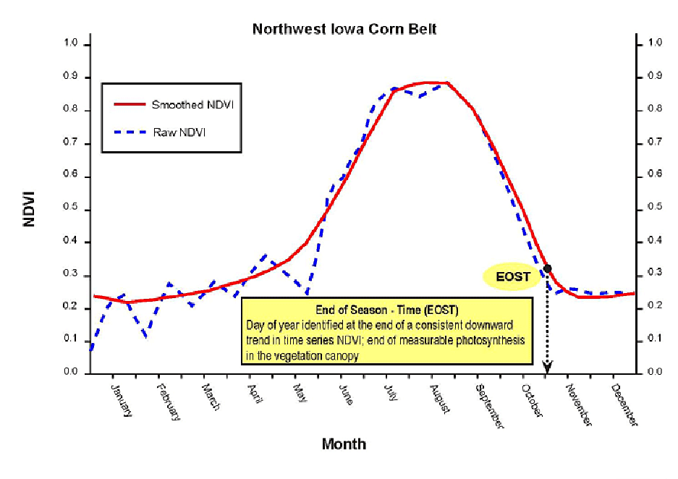

LANDSAT – end of season
USGS remote sensing phenology
Notes:
We are using landsat images from many different years, and we have to put them in the same order based on the end of season date, which does not always match up with the calendar date. End of season date with and end of season NDVI, where downward trend in NDVI levels. Off there are existing models of the smoothing function end of season, but they tend to be over-smoothed so Phil is working on developing their own from MODIS data.

Slide 14
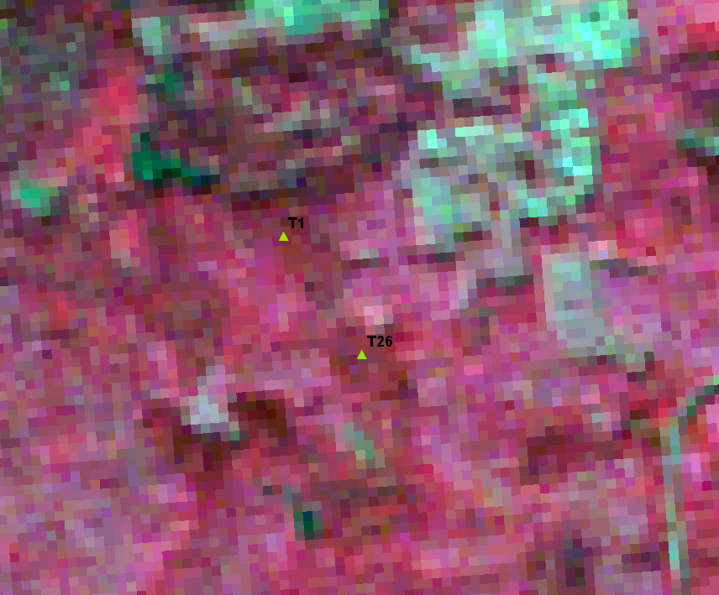

Slide 15
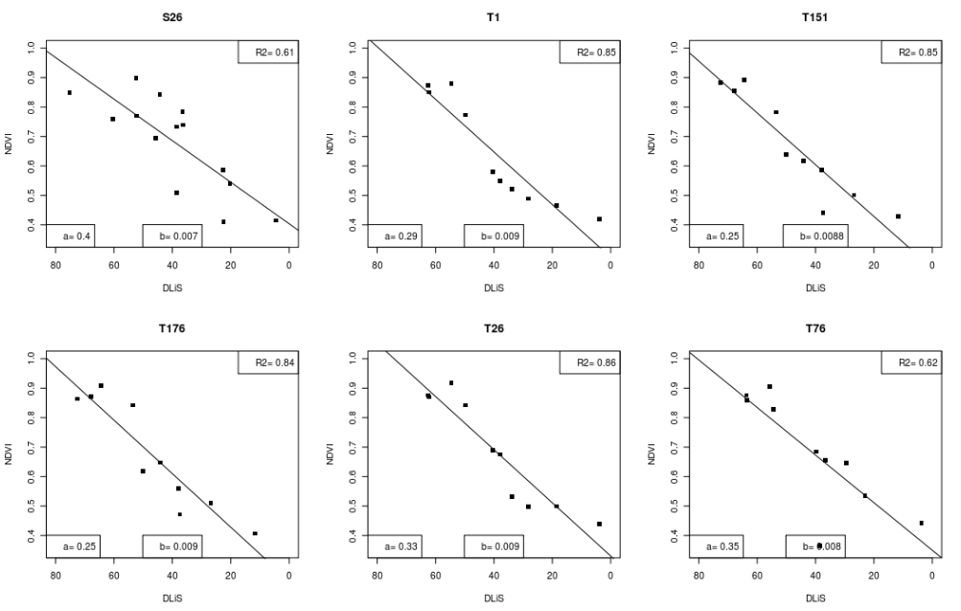
Notes:
With just preliminary data and incomplete LANDSAT history, intercepts are different, slopes are not.

Slide 16
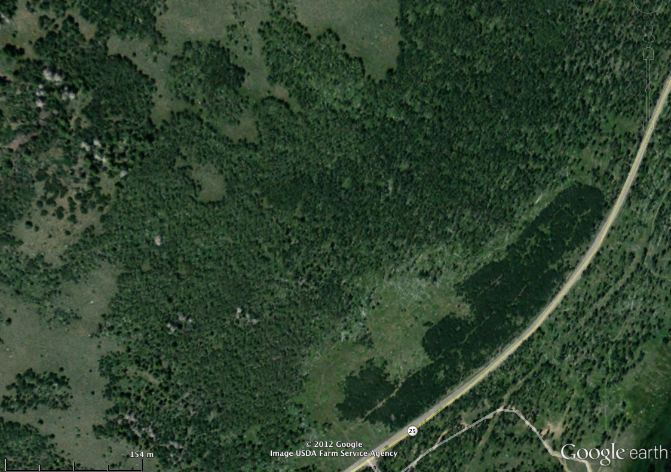

Slide 17
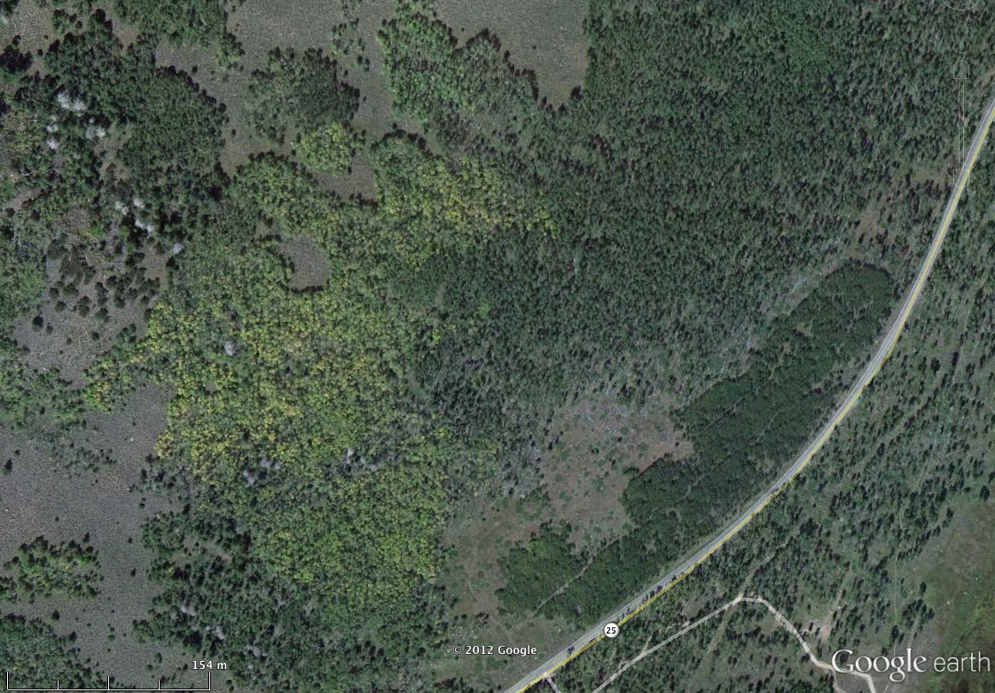
Notes:
March 2011

Slide 18
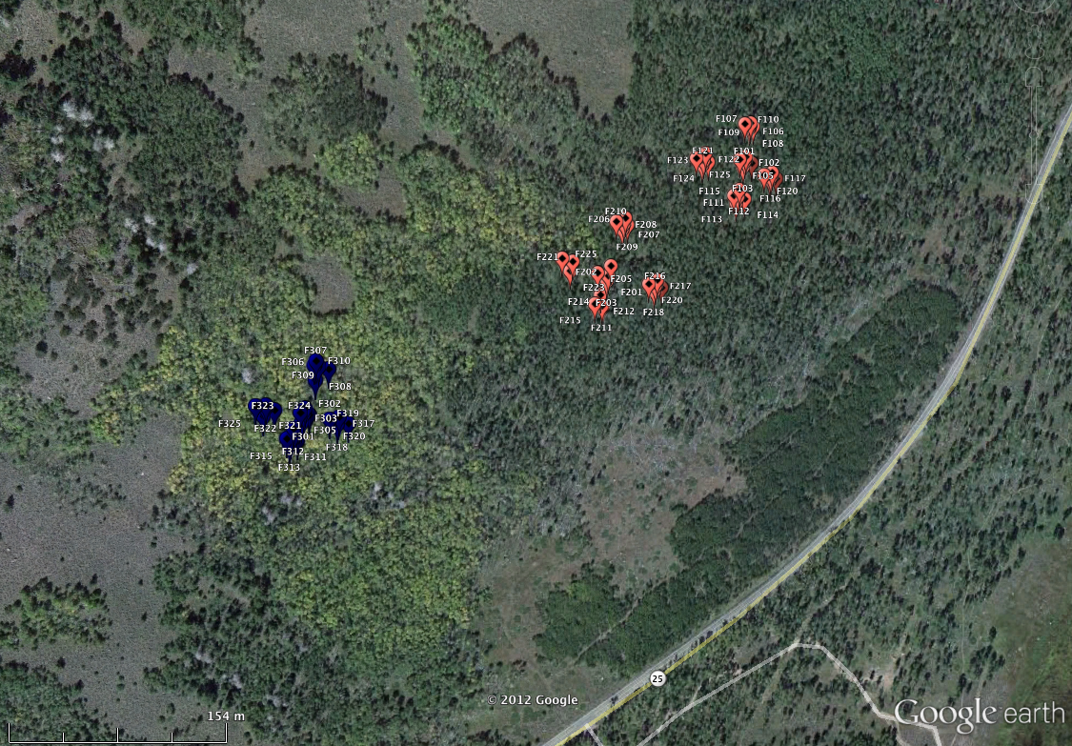
Notes:
October 2011

Slide 19
Hyperspectral data
Notes:
19

Slide 20
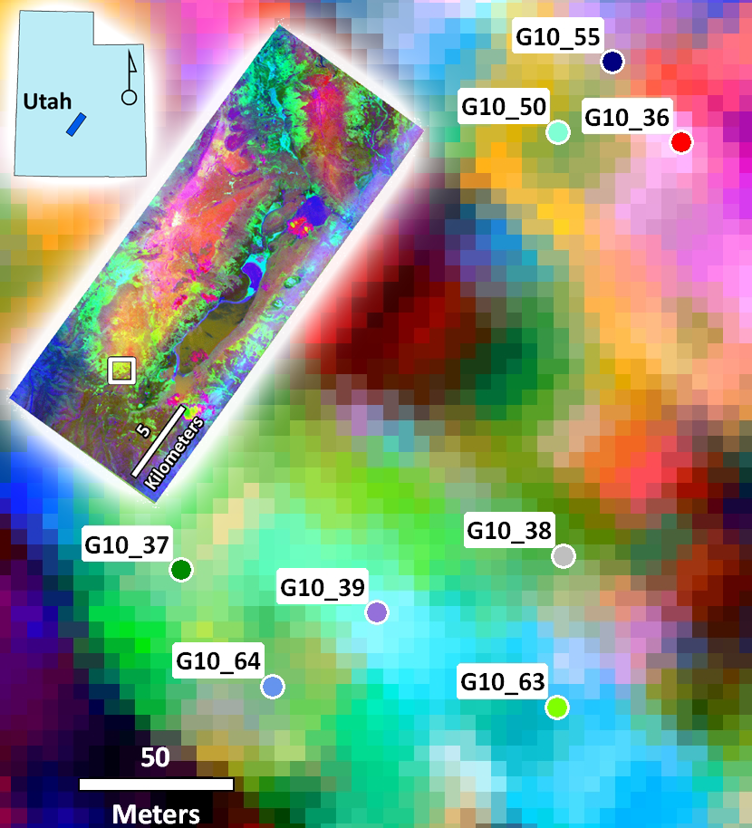
Notes:
TAFKAA…. ultimately we will have ATCOR corrected data
Minimum-noise fraction (MNF) transform of an August, 2010 224-band AVIRIS image over Fishlake NF, Utah (inset). Image demonstrates spectral differences among 8 geographically proximal aspen clones (different color circles).

Slide 21
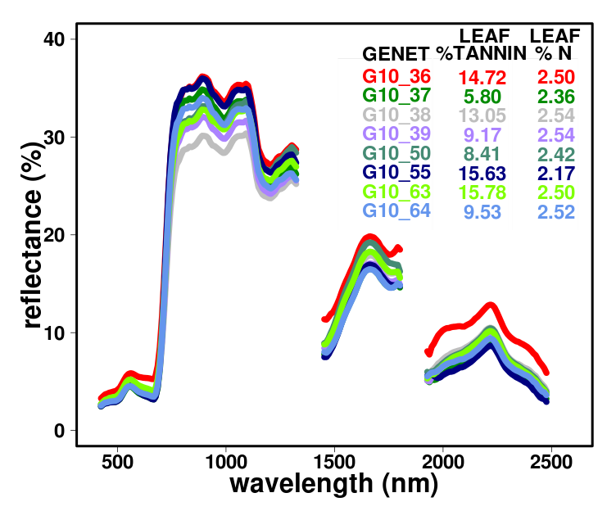
Notes:
Average AVIRIS spectral reflectance of the 8 aspen clones shown in Fig. 3 (same symbol color). Similar differences are detectable among clones elsewhere in the Rockies and the Upper Midwest.

Slide 22
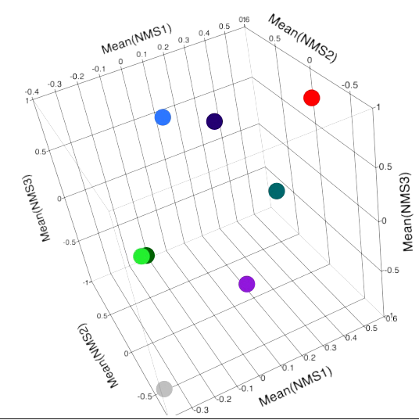
Genotypes have distinct spectral signatures
MRPP
T = -11.1
A = 0.23
P <0.001

Slide 23
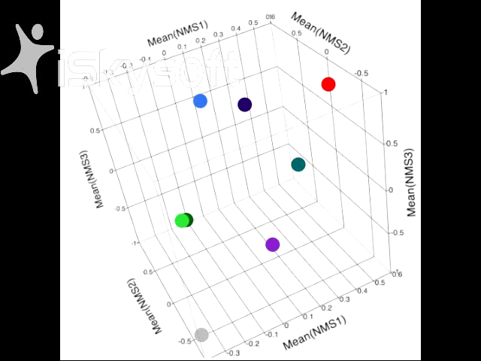
Double-click graphic to play movie
Notes:
3 NMS axis ~ 90% variation in spectra

Slide 24
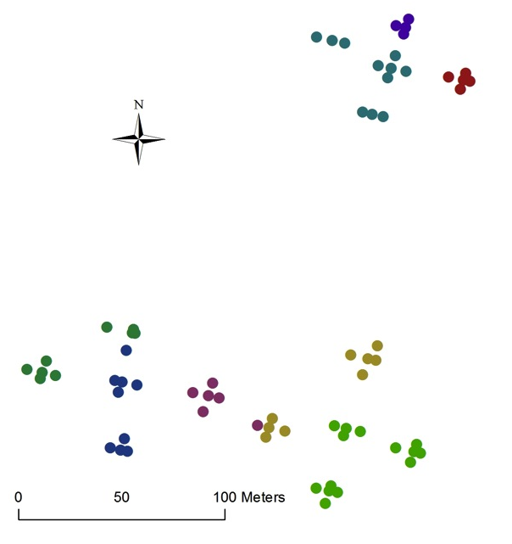
Genotypes are clumped spatially
MRPP P < 0.01

Slide 25
Genotypes are clumped spatially
Genotypes have distinct soil enzyme functioning profiles
MRPP P < 0.01
Soil enzyme NMDS

Slide 26
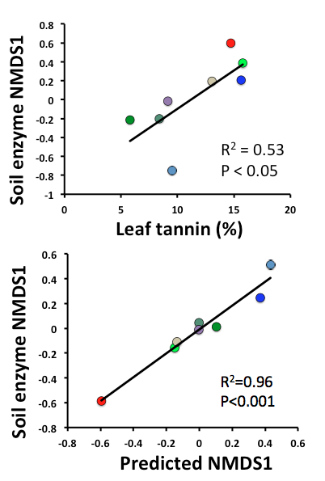
Soil microbial function is related to canopy chemistry

Slide 27
Soil microbial function is related to canopy chemistry
AVIRIS imagery of forest canopy predicts variation in belowground soil functioning

Slide 28
Remote sensing summary
LANDSAT
  Promising, long data series needed, may work better on larger clones
AVIRIS
  Expected relationships between canopy chemistry and reflectance persists within species
  Genotypes vary with spectral signature
  Canopy spectra correlated with belowground microbial function

Slide 29
Notes:
29

Slide 30
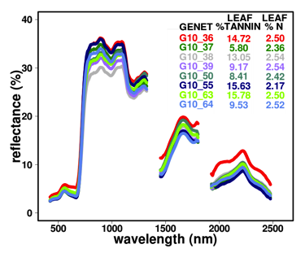
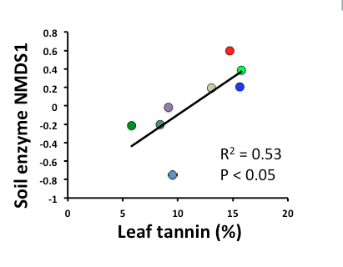
Notes:
30

Slide 31
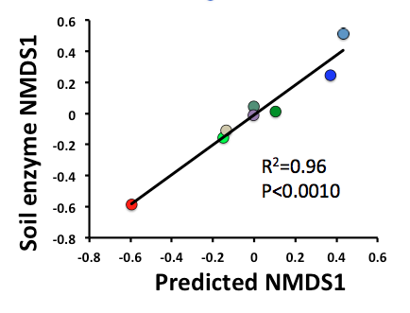
Notes:
31

Slide 32
What this allows us to do:
At large spatial scales:
  How does variation in canopy chemistry drive variation in belowground processes?
  How important is genetic diversity to soil processes?
  How does genetic diversity vary with ecoregion?
Future :
  What about herbivory?
  What about mixed species systems?
  Interactive effects of biodiversity and herbivory on ecosystem processes at landscape scales in forested ecosystems

Slide 33
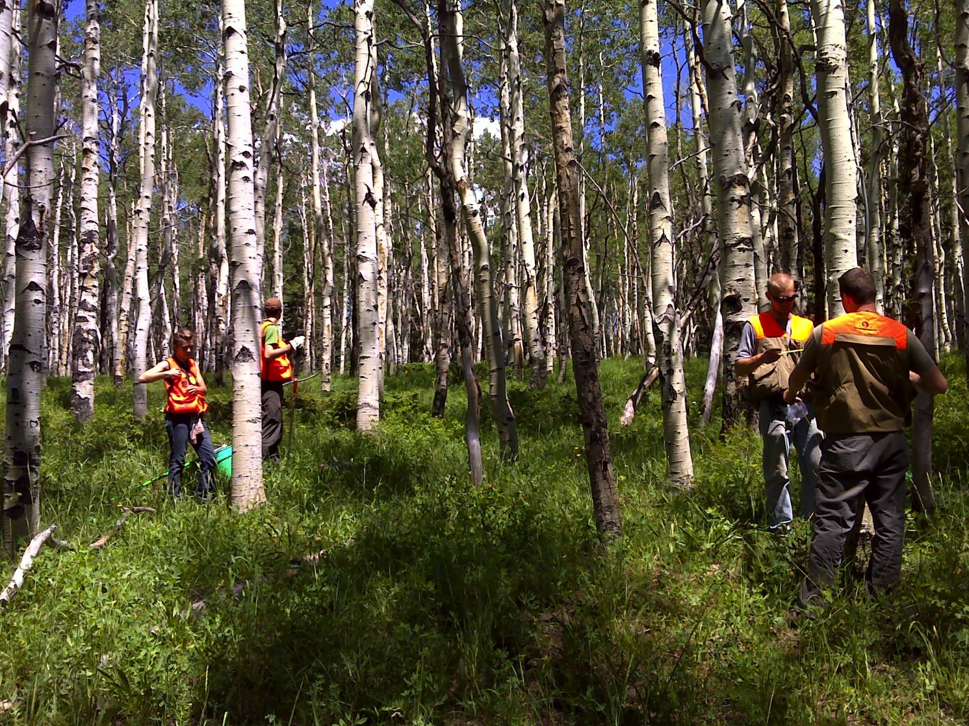
Acknowledgements
NASA
Clayton Kingdon
Peter Wolter
Timothy Whitby
Aditya Singh
Jacqui Bryant

Slide 34
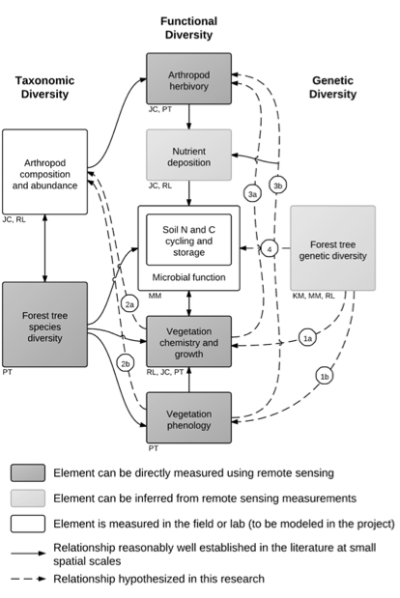
  Interactive effects of biodiversity and herbivory on ecosystem processes at landscape scales in forested ecosystems

Slide 35
AVIRIS Pre-processing: Steps
Aditya Singh
Uncorrected image
1) Cloud, shadow, water mask
2) Cross-track correction
3) Remove redundant bands
4) Atmospheric correction
5) Terrain normalization
Notes:
TAFKAA…. Ultimately ATCOR corrected data

Slide 36
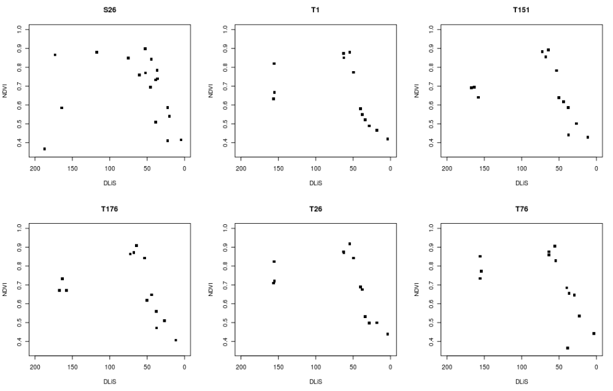
Notes:
NDVII on the y-axis, Days left in season on the x for 6 clones. 6 sites where we have at many ramets of the same genotype in a cluster.

Slide 38
AVIRIS spectral analysis

Slide 39
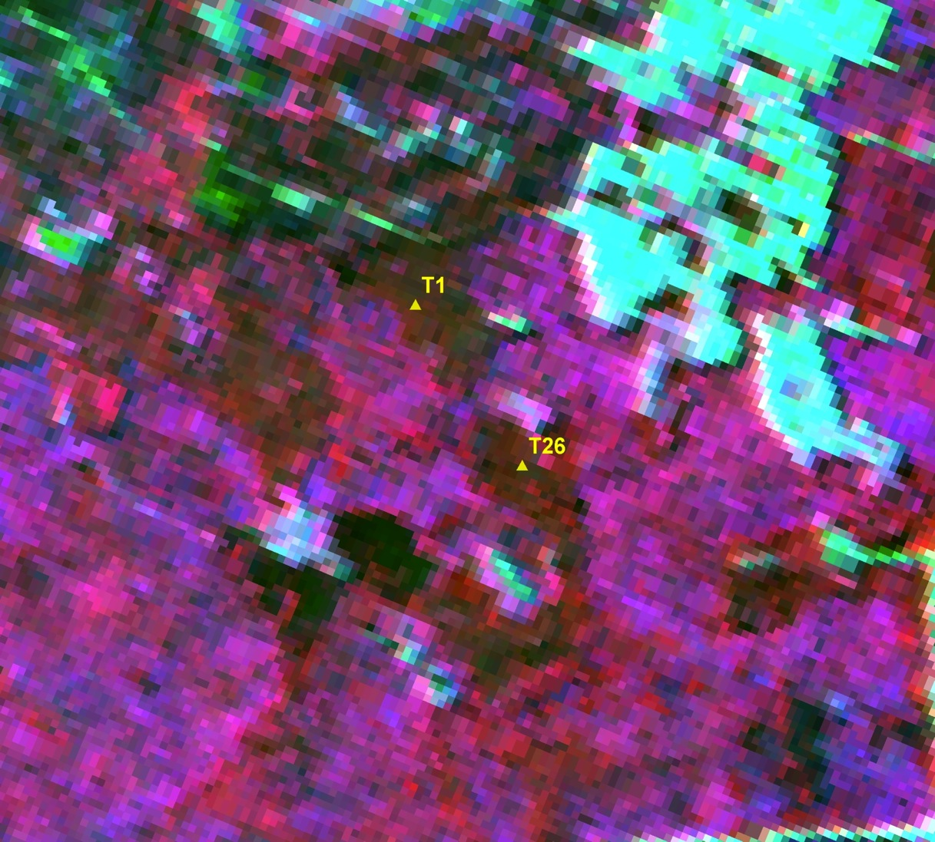
Notes:
'432' and '542' refer to the composite, which is aligned to Landsat bands. So ...
5 ~1650 nm
4 ~830 nm
3 ~660 nm
2 ~560 nm

Slide 40
Nitrogen Concentration
2.37%
2.31%
2.20%
2.32%
2.11%
Notes:
Curran et al.: key absorption bands associated with nitrogen bonds at 1020, 1510, 2060, 2130, 2180, and 2300 nm, others: absorption bands associated with nitrogen, proteins or amino acids at or near 1180–1200 nm, 1460 nm, 910 and 2350 nm.

Slide 41
